Slide 1
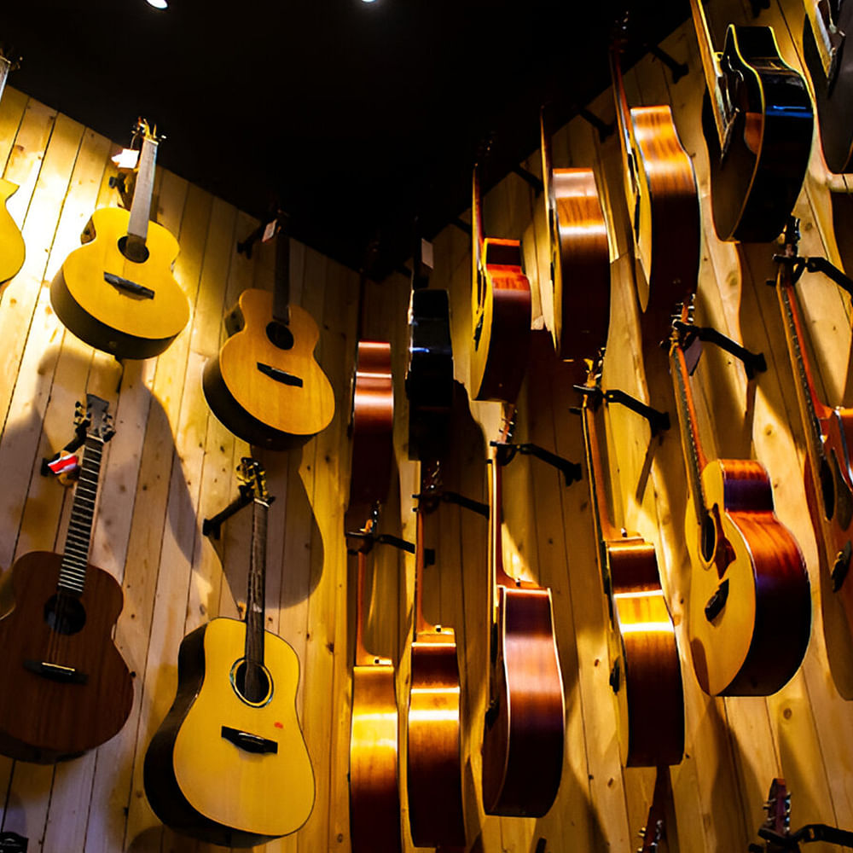
Chinook Music Store Analysis
SWATHI NS

Slide 2

Agenda
Problem Statement
Data Description
Objective Key Metrics and Visualizations
Subjective Question for Insights

Slide 3

Problem Statement
Analyse music record sales data to gain insights and make recommendations for the company's strategy in the physical music market

Slide 4
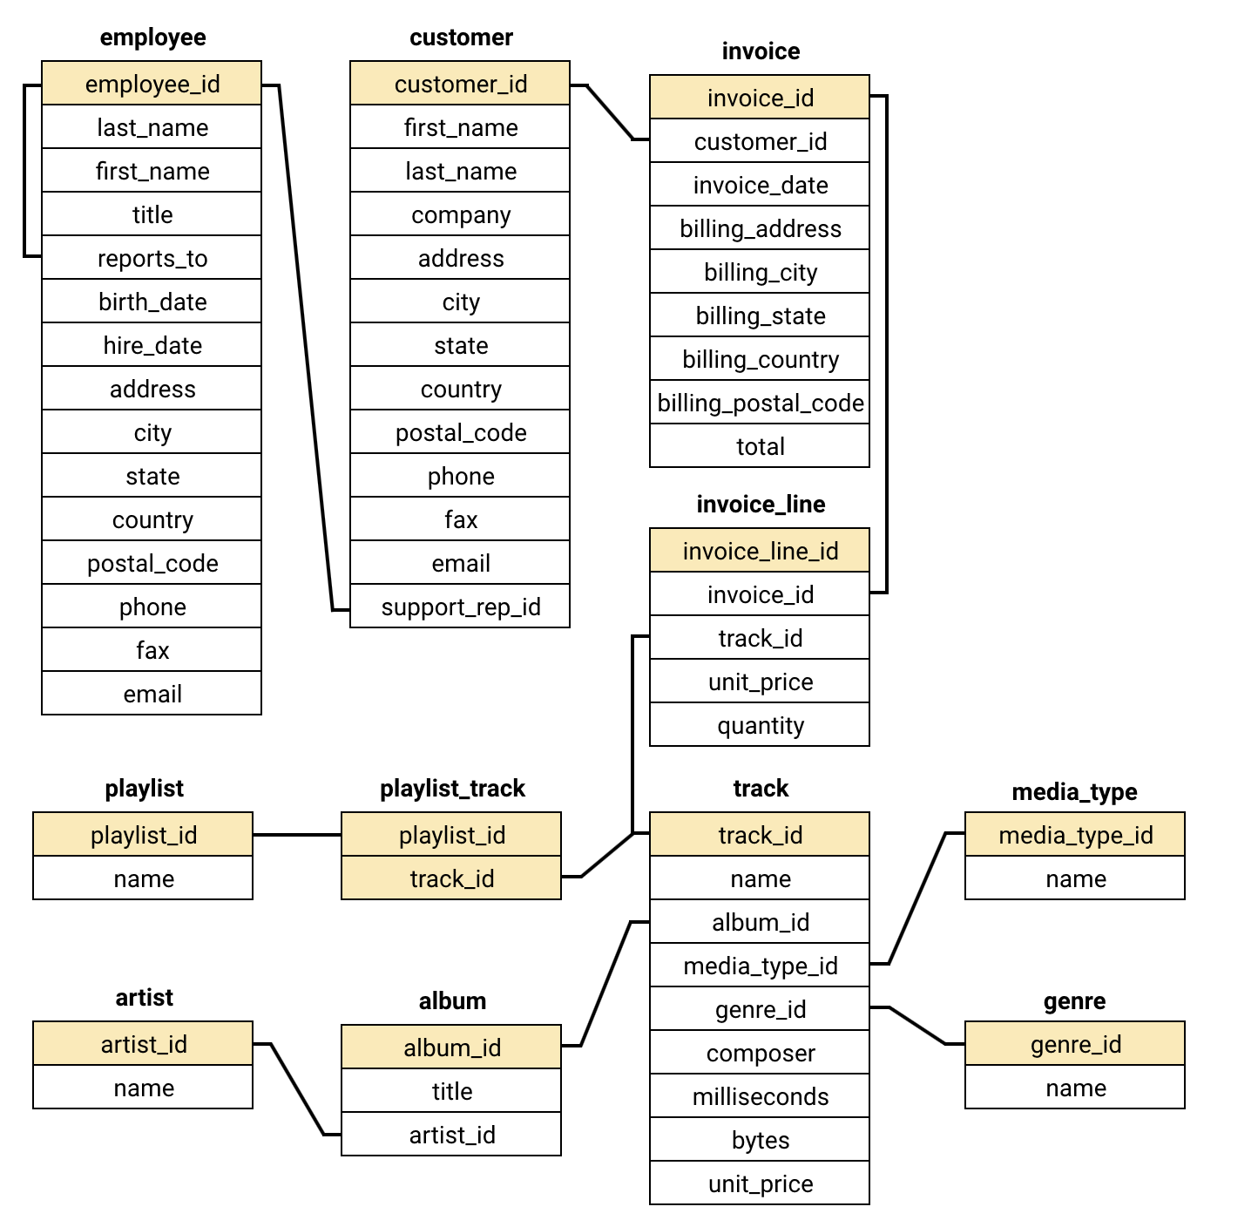
Database schema

Slide 5

Data overview
The dataset comprises 11 interconnected tables containing comprehensive information about the company’s operations.
Chinook serves a diverse customer base spanning 24 countries worldwide.
The music catalog features 25 distinct genres, including Rock, Metal, Jazz, and many others.
Each track is linked to detailed information about its corresponding album and artist.
All company transactions are captured in the Invoice table, which serves as a central record of purchases.

Slide 6
Data description
customer:
customer_id: unique identifier assigned to each customer.
first_name: the given name or first name of a customer.
last_name: the surname or family name of a customer.
company: the name of the company associated with a customer.
address: the street address of a customer's location.
city: the city where a customer is located.
state: the state or province where a customer is locaed.
country: the country where a customer is located.
postal_code: the postal or zip code of a customer's address.
phone: the phone number of a customer.
fax: the fax number associated with a customer.
email: the email address of a customer.
support_rep_id: the employee id of the support representative assigned to a customer.
invoice:
invoice_id: unique identifier assigned to each invoice.
customer_id: the customer id associated with the invoice.
invoice_date: the date when the invoice was generated or issued.
billing_address: the street address used for billing purposes.
billing_city: the city used for billing purposes.
billing_state: the state or province used for billing purposes.
billing_country: the country used for billing purposes.
billing_postal_code: the postal or zip code used for billing purposes.
total: the total amount due on the invoice.

Slide 7
Data description
invoice:
invoice_id: unique identifier assigned to each invoice.
customer_id: the customer id associated with the invoice.
invoice_date: the date when the invoice was generated or issued.
billing_address: the street address used for billing purposes.
billing_city: the city used for billing purposes.
billing_state: the state or province used for billing purposes.
billing_country: the country used for billing purposes.
billing_postal_code: the postal or zip code used for billing purposes.
total: the total amount due on the invoice.
playlist_track:
playlist_id: the id of the playlist to which the track belongs.
track_id: the id of the track included in the playlist.
track:
track_id: unique identifier assigned to each track or song.
name: the title or name of the track.
album_id: the id of the album to which the track belongs.
media_type_id: the id of the media type associated with the track.
genre_id: the id of the genre associated with the track.
composer: the name of the composer or artist who composed the track.
milliseconds: the duration of the track in milliseconds.
bytes: the file size of the track in bytes.
unit_price: the price per unit for the track.
PLAYLIST:
playlist_id: unique identifier assigned to each playlist.
name: the name or title of the playlist.

Slide 8
Data description
INVOICE_LINE:
invoice_line_id: unique identifier assigned to each line item on an invoice.
invoice_id: the invoice id to which the line item belongs.
track_id: the id of the track or product included in the line item.
unit_price: the price per unit for the line item.
quantity: the quantity of units for the line item.
media_type:
media_type_id: unique identifier assigned to each media type.
name: the name or description of the media type (e.g., mpeg audio file, aac audio file).
genre:
genre_id: unique identifier assigned to each genre.
name: the name or description of the genre (e.g., rock, pop, classical).
album:
album_id: unique identifier assigned to each album.
title: the title or name of the album.
artist_id: the id of the artist associated with the album.
artist:
artist_id: unique identifier assigned to each artist.
name: the name of the artist.

Slide 9

Customer Segments
Customer Insights & Best-Selling Products
Customer Base
Best-Selling Tracks
Chinook’s customer base is predominantly located in the USA, UK, and Canada, which serve as the company’s primary markets.
"Rock" stands out as the top-selling track, with "The Posies" leading as the most popular artist. The dominant genres are "Rock" and "Metal."

Slide 10
Geographic Breakdown of Chinook’s Customer Base
Insights:-
USA dominates the customer base, significantly leading all other countries.
Canada and Brazil are the next top contributors, highlighting strong engagement across the Americas.
France, Germany, and the UK show moderate customer counts, indicating solid European presence.
Chinook has a broad international footprint, with customers spread across 20+ countries, though most have relatively small individual contributions

Slide 11
Top-Performing Genres in the U.S. Market
Insights
Rock leads with the highest sales and strong customer preference.
Moderate contributors: Metal, Alternative & Punk, R&B/Soul.
Low performers: Pop, Jazz, Latin, Classical, Electronic/Dance.
Negligible impact: TV Shows, Soundtrack, Easy Listening.

Slide 12
Recommendations
Boost Rock with targeted promotions & curated content
Promote mid-tier genres via artist spotlights & playlists
Review low performers for content gaps, pricing & demand
Revamp or retire non-performing genres (e.g., TV Shows, Soundtrack, Easy Listening)

Slide 13
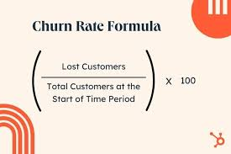
Customer Churn Rate Overview
Insights
The customer churn rate is 32.43%, indicating a significant loss of customers.
This suggests that customer retention is currently weak.
A high number of customers have discontinued, which may impact long-term growth and revenue.

Slide 14
Recommendations
Implement retention strategies such as loyalty programs, personalized offers, and proactive engagement.
Enhance customer experience through feedback loops, improved support, and quality service.
Analyze churn patterns to identify at-risk segments and take preventive actions.

Slide 15
Customer Purchase Behavior Insights
Insights
Long-term customers spend ~44% more than short-term.
Higher basket size: 2762 vs. 1995.
More frequent purchases: 32 vs. 27.
Recommendations
Boost retention with loyalty programs & exclusive perks.
Enhance onboarding to nurture short-term customers.
Use personalized offers to drive repeat purchases.
Upsell & cross-sell to increase basket size.
Identify churn drivers and fix friction points.

Slide 16
Customer Risk Profiling:
Insights
USA has the highest customer tenure by far, indicating a strong, loyal customer base.
Canada and Germany follow as the next top countries with long customer tenures.
Several countries (e.g., Belgium, Austria, Portugal, Spain) show relatively low tenure, suggesting either fewer customers or less engagement.
Other notable contributors: Brazil, France, United Kingdom, and Czech Republic.

Slide 17
Recommendations
Focus retention efforts in high-tenure markets (USA, Canada, Germany) to further strengthen loyalty and expand offerings.
Investigate low-tenure regions (e.g., Austria, Belgium, Portugal) to understand barriers to customer longevity—consider targeted promotions or localized support.
Explore growth opportunities in mid-tier tenure countries like UK, Brazil, and Czech Republic, where moderate loyalty indicates room for improvement.
Use customer feedback and satisfaction surveys in low-tenure countries to identify friction points in the customer journey.

Slide 18




Strategic Recommendations
Strengthening Customer Loyalty
Prioritize initiatives aimed at retaining existing customers by implementing loyalty programs, offering personalized recommendations, and enhancing overall engagement.
Optimized Promotion Strategy
Develop focused promotional efforts aimed at top-selling genres and valuable customer segments to boost overall sales performance.
Diversifying Music Offerings
Identify and introduce trending or niche music genres to expand the catalog, attract a wider audience, and tap into new market segments.

Slide 19
Conclusion
Chinook holds a solid position in the physical music market, supported by a loyal and consistent customer base.
Long-term customers show stable purchasing patterns, presenting opportunities to deepen engagement and increase sales.
By enhancing the loyalty program, offering personalized recommendations, and focusing on high-potential genres, Chinook can boost customer satisfaction and drive revenue.
A strategic emphasis on personalized marketing and data-driven insights will reinforce Chinook’s leadership in the industry and promote sustainable growth.
Implementing these strategies will pave the way for long-term success and profitability in a competitive landscape.

Slide 20
Thank you

